Slide 1
Alberta
Super Simple Grid Mix Simulator
Presented by Chris Lashmar (clashmar@gmail.com)

Slide 2
Agenda
Motivation
Background
Method
Caveats
Review of the model and play with some scenarios
  Capture ideas to explore later
Conclusions
Next Steps

Slide 3
Motivation to Create the Model
Solar modules are cheap!!!
Solar potential in Alberta is high
Battery prices are dropping
Some pundits say solar + storage competes with traditional sources
So why isn’t Alberta deploying solar + battery storage at a much higher rate?
What is the optimum mix of solar, wind, storage and hydro, given various sets of assumptions?

Slide 4
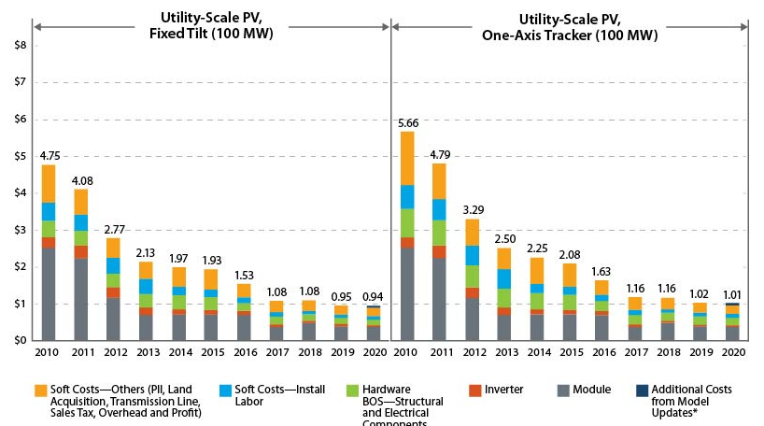
Solar modules are cheap!!!
$0.94 USD/watt in 2020 (Utility Scale, including installation)
Amounts are in USD. Source: https://www.nrel.gov/news/program/2021/documenting-a-decade-of-cost-declines-for-pv-systems.html

Slide 5
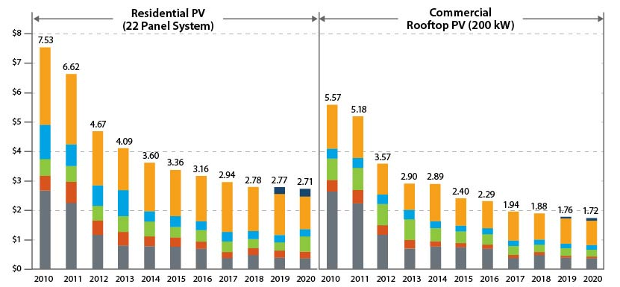
Solar modules are cheap!!!
$0.271 USD/watt in 2020 (Residential PV)
Amounts are in USD. Source: https://www.nrel.gov/news/program/2021/documenting-a-decade-of-cost-declines-for-pv-systems.html

Slide 6
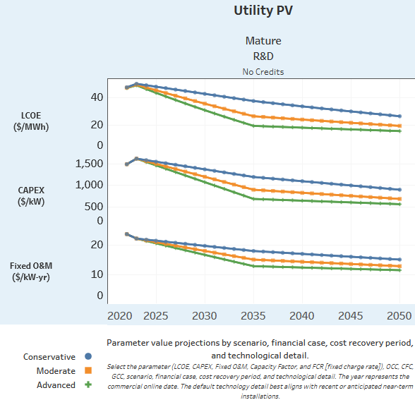
Solar modules are cheap!!!
Or was it $1.50 USD/watt?
Amounts are in USD. Source: https://atb.nrel.gov/electricity/2024/utility-scale_pv

Slide 7
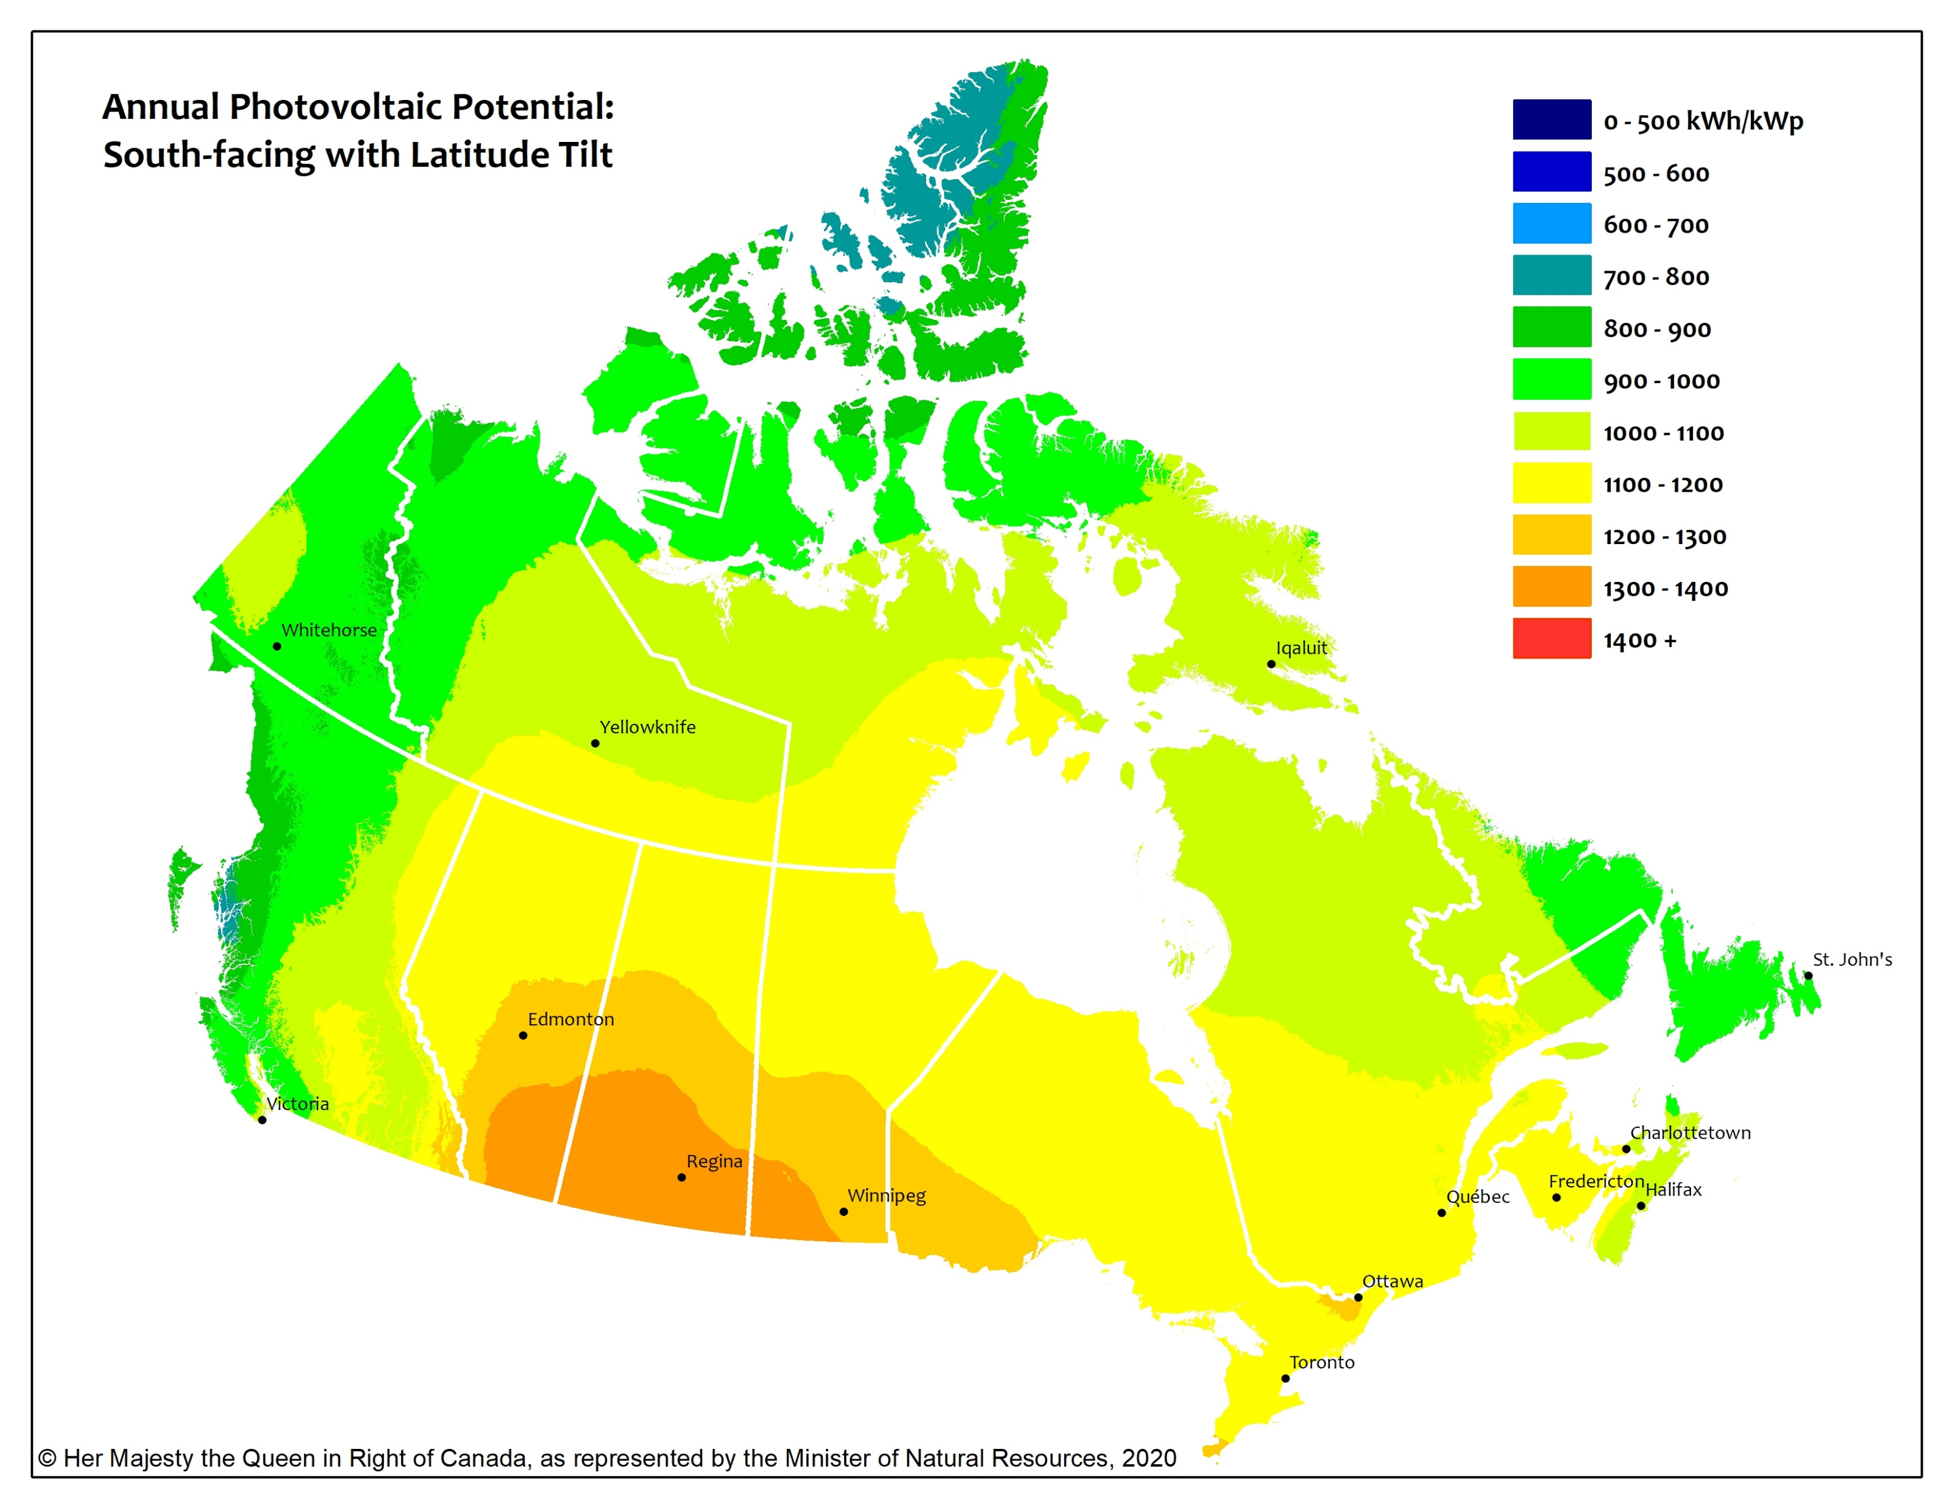
Alberta Annual Photovoltaic Potential

Slide 8
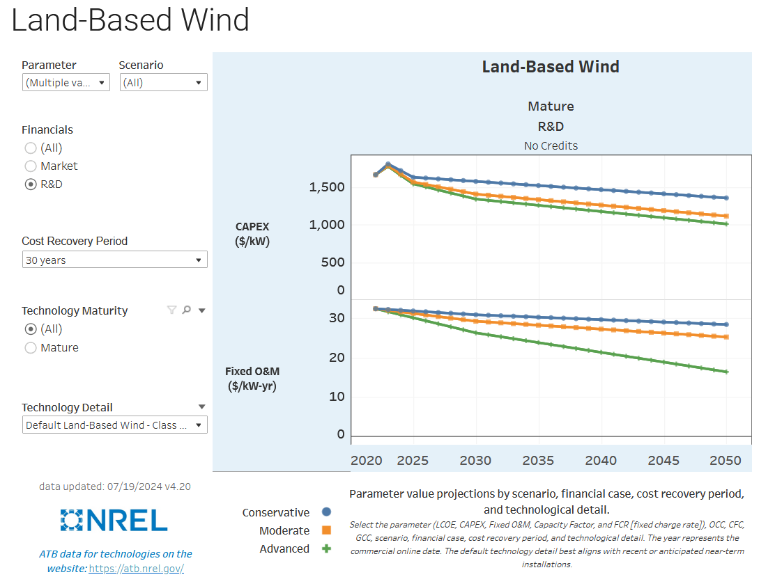
Land-Based Wind (USD)
Amounts are in USD. Source: https://atb.nrel.gov/electricity/2024/land-based_wind

Slide 9
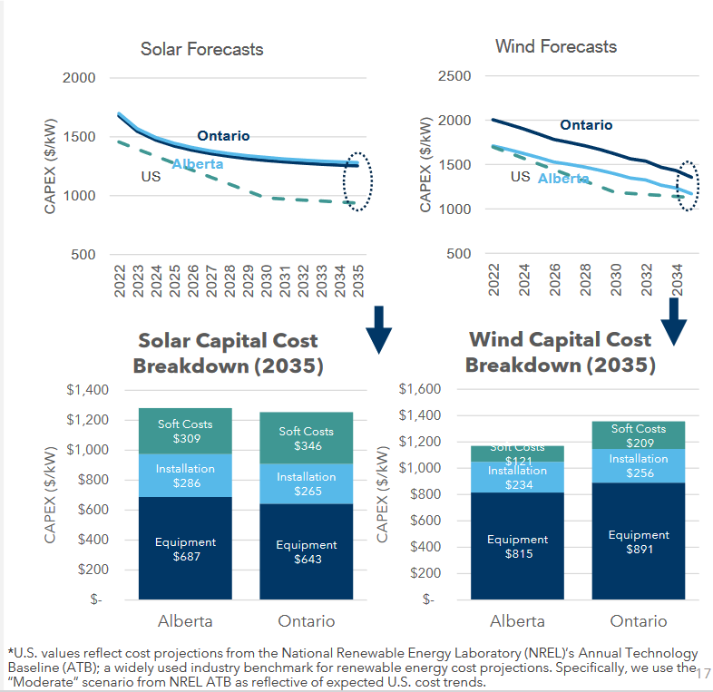
Wind Regional Cost Variations
Source: https://cleanenergycanada.org/wp-content/uploads/2023/01/RenewableCostForecasts_CleanEnergyCanada_Dunsky_2023_SlideDeck.pdf
Amounts are in USD. Source: https://atb.nrel.gov/electricity/2024/land-based_wind
Notes:
Supported

Slide 10
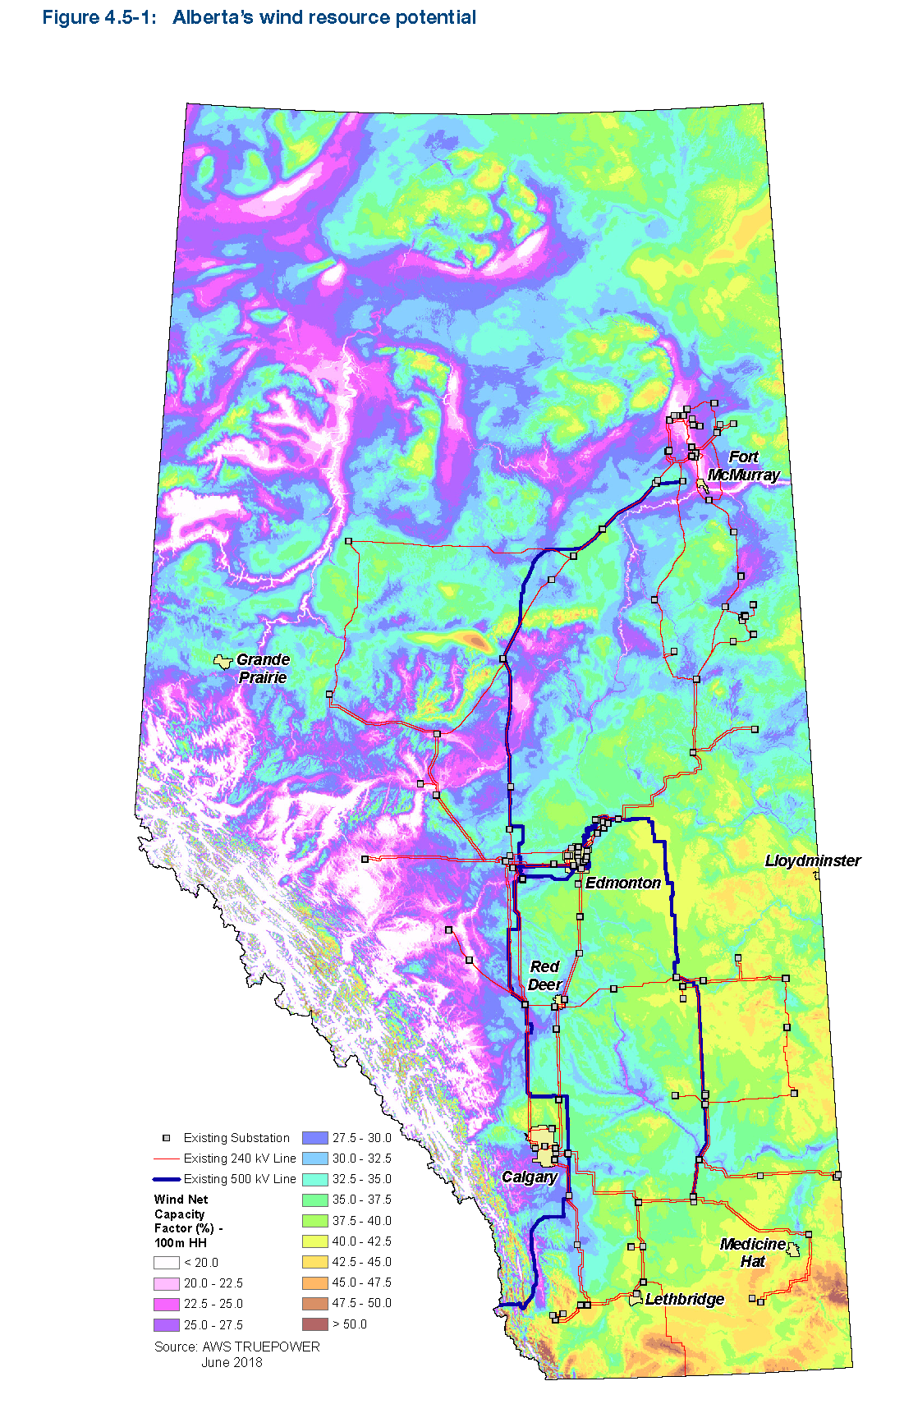
Alberta Wind Potential
Source: https://renewablesassociation.ca/wp-content/uploads/2020/09/AESO-2020-Long-termTransmissionPlan-Final_Page_33.png

Slide 11
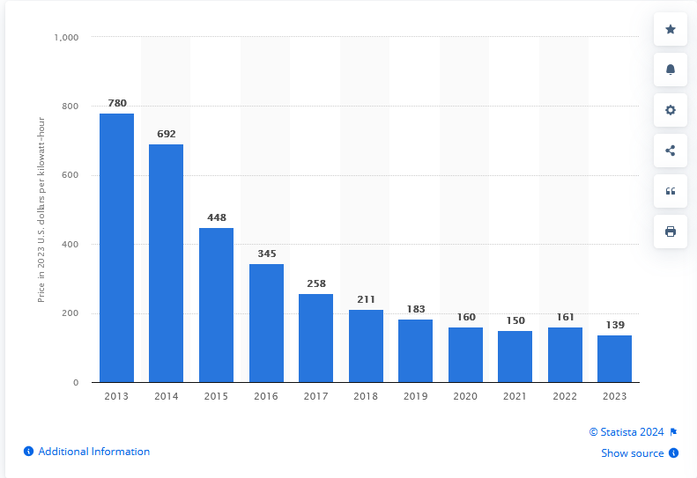
Lithium-ion battery pack price worldwide
Source: https://www.statista.com/statistics/883118/global-lithium-ion-battery-pack-costs/
In 2023 U.S. $/kWh
11 %
35 %
23 %
25 %
18 %
13 %
13 %
6 %
-7 %
14 %

Slide 12
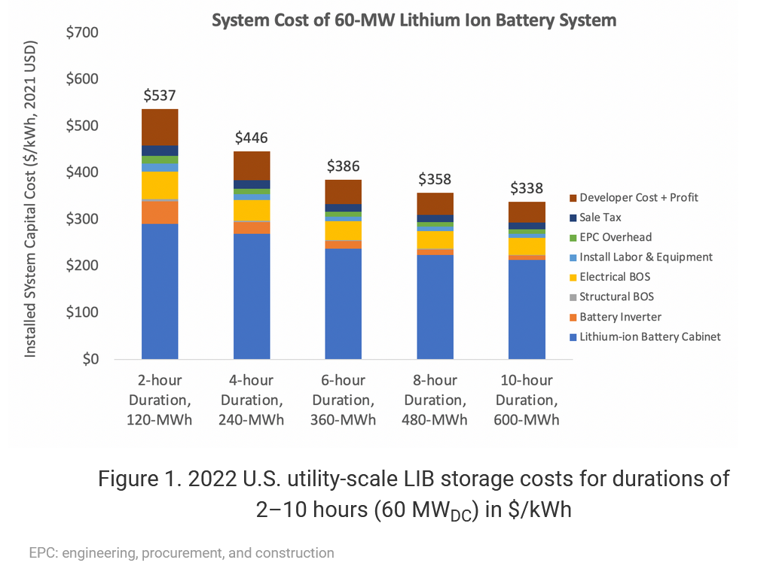
Source: https://atb.nrel.gov/electricity/2023/utility-scale_battery_storage

Slide 13
Lithium-ion battery price worldwide
But also in April 2024, Bloomberg NEF reports:
“The global energy storage market almost tripled in 2023, the largest year-on-year gain on record. Growth is set against the backdrop of the lowest-ever prices, especially in China where turnkey energy storage system costs in February were 43% lower than a year ago at a record low of $115 per kilowatt-hour for two-hour energy storage systems”
Source: https://about.bnef.com/blog/global-energy-storage-market-records-biggest-jump-yet/

Slide 14
Method
Download hourly data from the Alberta Electrical Systems Operator for 2018-2023
  Actual load
  Solar PV power generation
  Window power generation
  Hydro power generation
Create Excel workbook that allows us to test the effects of changing installed solar, wind and battery storage on cost and power availability

Slide 15
Caveats
"All models are wrong but some are useful“ – George Box
Modelled hydro output is based on the actual output during the periods modelled. If the modelled scenario was happening in real life, it is possible that the hydro output would be managed differently
Future installations of wind may have lower capacity factors because the best locations are probably already used.
Locations of solar and wind installations may not align with existing transmission capabilities and so may require significant transmission changes.

Slide 16
Model Demo

Slide 17
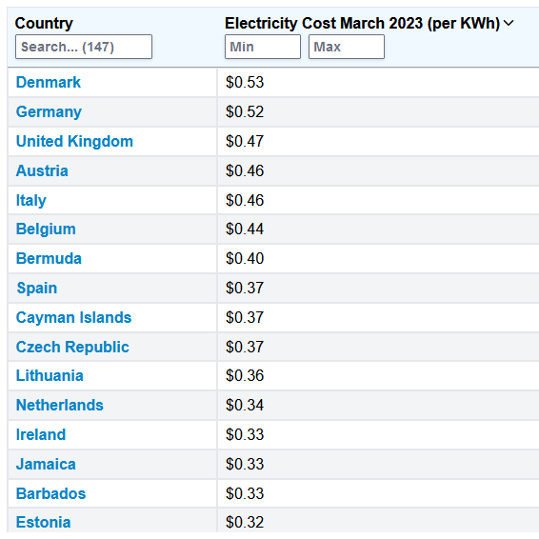
Comparison to Other World Power Prices
Source: https://worldpopulationreview.com/country-rankings/cost-of-electricity-by-country

Slide 18
Conclusions
Alberta power prices ($/kWh) with today’s prices for wind, solar and batteries might be competitive with a few of the countries with the most expensive electricity in the world. This would be x times more expensive than what we currently pay.
There is a high level of uncertainty with these conclusions because of the caveats previously identified.

Slide 19
Next Steps
Model changes?
  Gas + CCS?
  Nuclear
  Larger interties to the U.S. with assumed solar in Arizona?
  Hydro changes?
  Demand management?
  Demand changes due to mass electrification
    EV uptake
    Electrification of heating

